Slide 1
Philip Demeri Springboard Data Science Career Track Capstone Project #2 Stock Selection Using Classification and Ensemble Models

Slide 2
Aim
To predict the relative future stock returns using data related to the stocks’ historic prices and industry reporting metrics. At a given time t, given an array of features, the aim is to predict which stocks will outperform the median stock return over the next month and which will underperform.
Three supervised classification algorithms will be implemented: logistic regression, K-nearest neighbors, and random forest classifier
Three ensemble models will be implemented: voting classifier, bagging, and AdaBoost classifier

Slide 3
The Data
Over 20 years of monthly data from the financials sector of the S&P 1500 Index:
The data range from December 1994 to July 2015
The S&P 1500 Index consists of 1,500 large-cap US stocks
The financials sector consists of banks, insurance companies, etc.
At each month, the financials sector consists of 100 to 300 stocks, with the count increasing over time

Slide 4
The Features
The features are drawn from the stocks’ historical prices and accounting data:
Sales-to-price: a company’s last twelve months’ (TTM – trailing twelve months) sales divided by the stock price at time tThe S&P 1500 Index consists of 1,500 large-cap US stocks
Book-value-to-price: a company’s TTM book value divided by the stock price at time t
ROA: a company’s TTM net income divided by TTM average total assets (average total assets is generally computed by averaging the value of a company’s assets at time t and the value of a company’s assets twelve months ago)
Earnings-per-share-to-price: a company’s TTM EPS (EPS is computed by dividing TTM net income by the number of common shares outstanding at time t) divided by the stock price at time t
Price momentum: a stock’s total return over the past month (total return includes not only share price but also any dividends per share that were paid)
EPS momentum: a company’s EPS at time t divided by EPS one quarter ago

Slide 5
The Target
The target is a stock’s next-month total return. For example, suppose it is the end of a month. Then, the target is the stock’s return over the next month, plus any dividends paid during the month.

Slide 6
Wrangling the Data
The target needed to be coerced to a float and any errors coerced to NaN
Not all observations were free of nulls for the features and/or the target – about 92% of all observations were free of any nulls, and hence it was decided to drop any observations containing at least one NaN rather than seek imputation
One of the features needed to be engineered from existing features that eventually were discarded: EPS momentum, which was engineered by dividing current EPS-to-price by the previous quarter’s EPS-to-price
Occasionally EPS equals zero, so the engineered feature led to + or -inf, which in both cases was coerced to + or -5 upon discretizing the features
All features and the target, which were continuous, were discretized – at each date, each feature was converted to 1 through 5 based upon the 20th-percentile quantile to which the data belonged, and the target was converted to 1 if it was greater than the median, and 0 otherwise

Slide 7
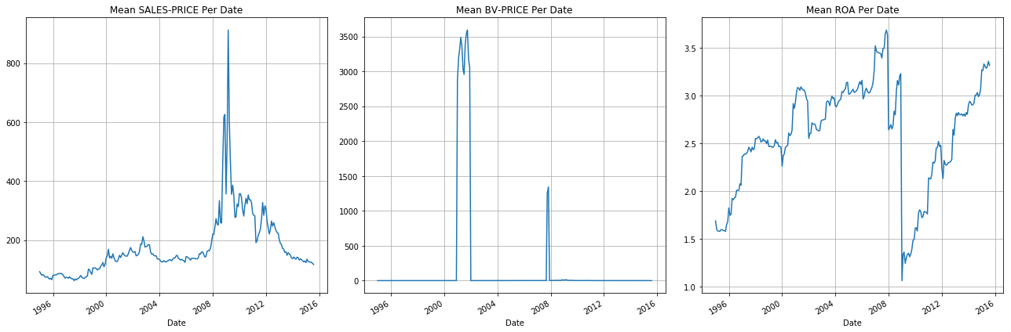
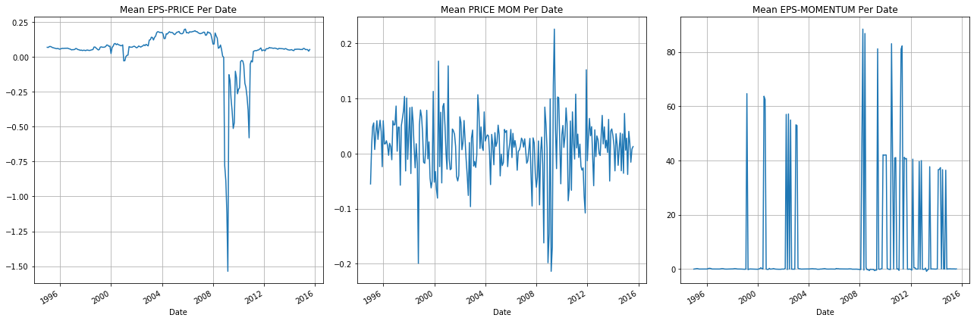
Feature averages over time, grouped by date

Slide 8
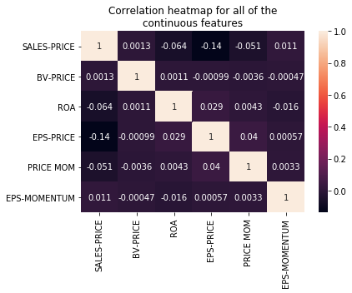
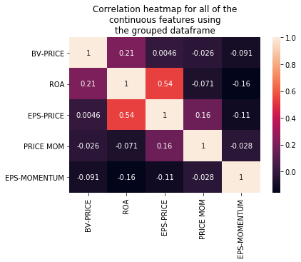
Heatmaps for the features across time and grouped by date

Slide 9
Regression outputs when the target is regressed on each feature
 | SALES_PRICE | BV_PRICE | ROA | EPS_PRICE | PRICE_MOMENTUM | EPS_MOMENTUM
t-stat | 4.620619 | -0.92283 | -0.390026 | -5.51E+00 | -1.51E+01 | -0.707716
P-value | 0.000004 | 0.3561 | 0.696519 | 3.65E-08 | 3.75E-51 | 0.479125
R² | 0.000425 | 0.000017 | 0.000003 | 6.04E-04 | 4.50E-03 | 0.00001

Slide 10
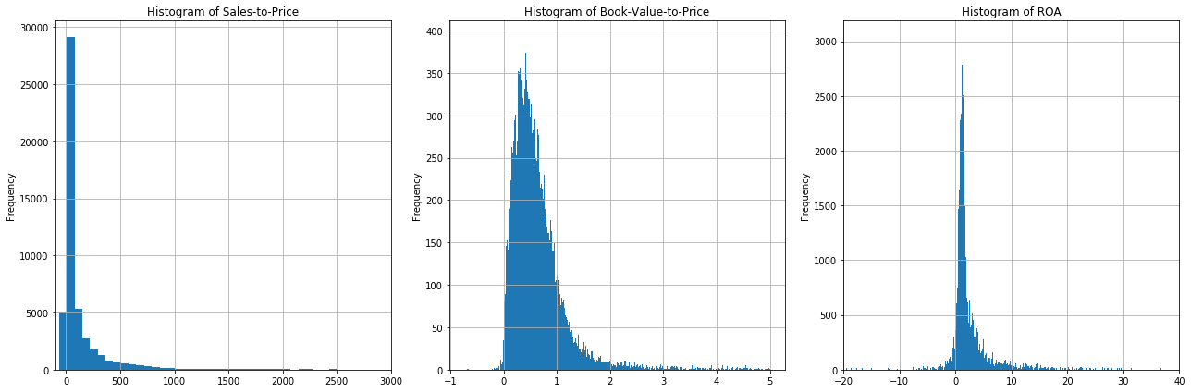
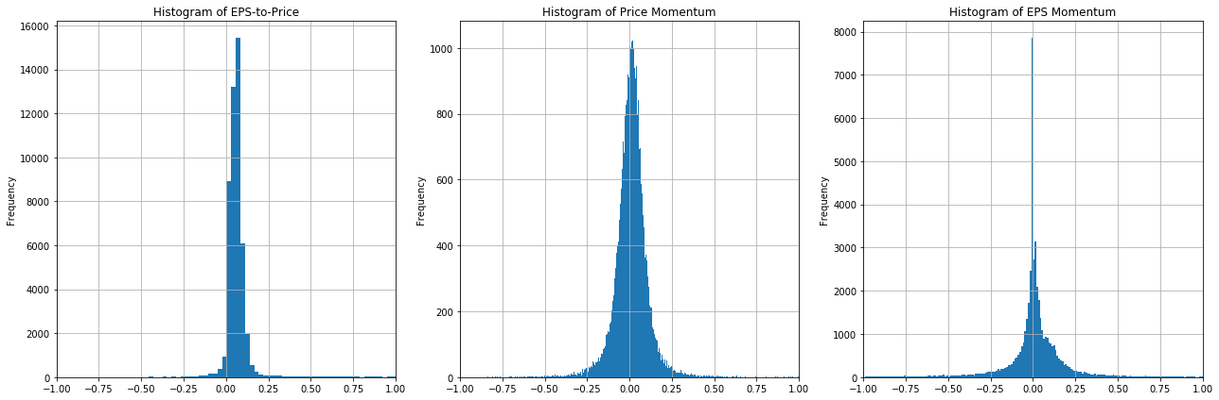
Histograms of each feature

Slide 11
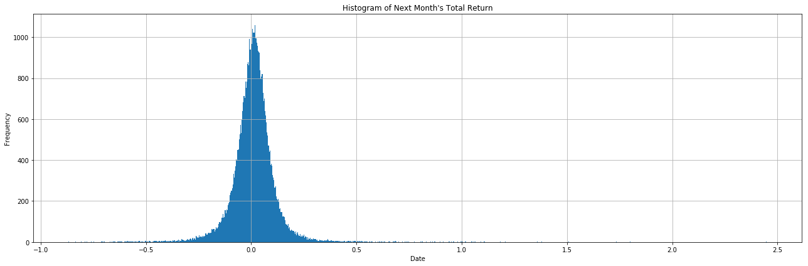
Histogram of the target

Slide 12
Skewness and kurtosis for the features and the target
 | Sales-to-Price | Book-Value-to-Price | ROA | EPS-to-Price | Price Momentum | EPS Momentum
Skewness | 29.619841 | 62.337431 | 3.860452 | -71.920511 | 0.949092 | 34.956608
Kurtosis | 1276.243455 | 3943.690512 | 30.669379 | 6685.896137 | 22.199481 | 1220.042161
 | Next Month's Total Return
Skewness | 0.905334
Kurtosis | 22.228679

Slide 13
Machine learning workflow
At each month, split the observations into 75% training, 25% testing
Report the accuracy in predicting the target
Initialize a random state for reproducibility
Using default hyperparameters
Run the logistic regression, KNN, and random forest classifiers across all months
Split the training set via ten-fold cross validation, re-run all three models, and compare the accuracy for the training, validation, and test sets
Run the voting classifier (for all 3 base estimators), bagging, and boosting, where the latter 2 use only the random forest as the base estimator
Using tuned hyperparameters
Tune each base model using the months from December 1994 to December 1996
Select each base model’s optimal hyperparameters, and re-run each from January 1997 to July 2015
Re-run each of the ensemble models from January 1997 to July 2015 using the tuned base estimators (all three for the voting classifier, and the random forest for bagging and boosting)

Slide 14
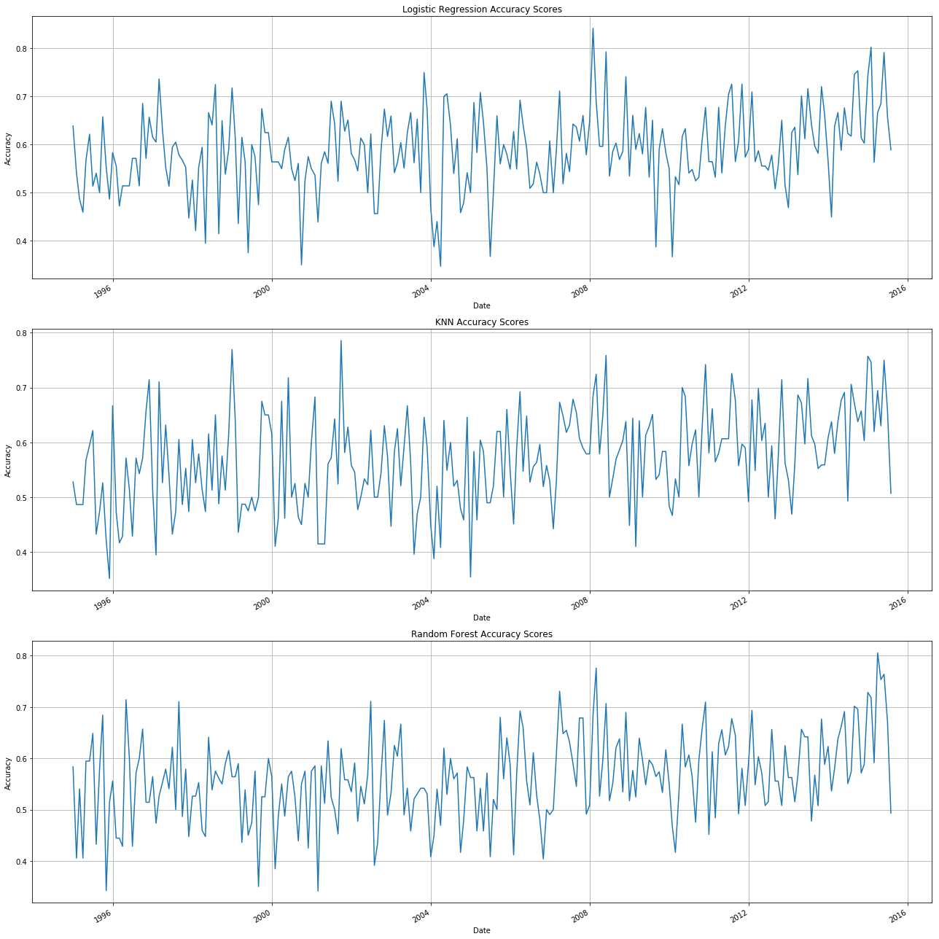
Accuracies of the untuned logistic regression, KNN, and random forest classifiers

Slide 15
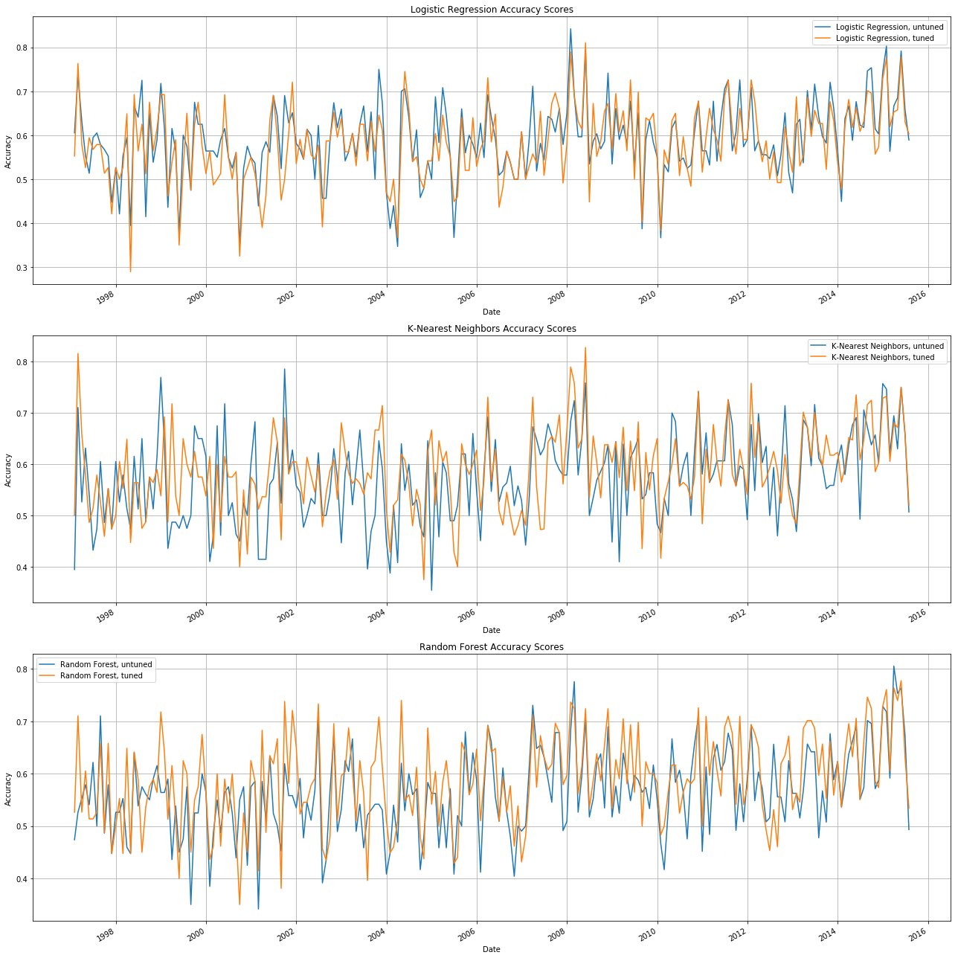
Accuracies of the tuned logistic regression, KNN, and random forest classifiers

Slide 16
Mean and variance of accuracies for the logistic regression, KNN, and random forest
 | Logistic Regression, untuned | Logistic Regression, tuned | K-Nearest Neighbors, untuned | K-Nearest Neighbors, tuned | Random Forest, untuned | Random Forest, tuned
Mean | 0.588994 | 0.580683 | 0.573058 | 0.587559 | 0.56382 | 0.58819
Variance | 0.007337 | 0.007403 | 0.007296 | 0.00633 | 0.00657 | 0.00758

Slide 17
Mean and variance of accuracies for the ensemble models
 | Voting Classifier, untuned | Voting Classifier, tuned | Bagging Test Set, untuned | Bagging Test Set, tuned | Bagging Out-of-Bag Set, untuned | Bagging Out-of-Bag Set, tuned | AdaBoost, untuned | AdaBoost, tuned
Mean | 0.585123 | 0.593566 | 0.58312 | 0.59146 | 0.587039 | 0.591346 | 0.562028 | 0.563571
Variance | 0.007205 | 0.007662 | 0.007537 | 0.007989 | 0.00535 | 0.005463 | 0.00648 | 0.007636

Slide 18
Conclusions
Accuracies slightly increased over time, due to the increasing number of financials stocks at each month – correlation between 0.25 and 0.39 among all models
Hyperparameter tuning led to improved average accuracy for all models except for logistic regression, yet slightly higher variance
All models witnessed accuracy between 55% and 60%
The base estimator with the best performance was the untuned logistic regressor
The ensemble model that performed best was the tuned voting classifier
The bagging classifiers witnessed the lowest variance out of all models
The random forest found the greatest improvement (2.5%) from tuning

Slide 19
Next steps
Modify the project by:
Discretizing across more quantiles for features and the target
Using a different sector or sectors as the universe to which the stocks belong
Selecting a sector with relatively many stocks, as it was observed that accuracy was positively correlated with the number of stocks
Lengthening the target beyond just the next month – consider the next quarter’s or year’s return
Tuning the hyperparameters at the ensemble, and not just the base estimator, level

